Slide 1

Smart Grievance Management System
by
M.Siva Kumar
Roll No. 184G1A0591
A.Krishna Sampada
Roll No. 184G1A05B5
K.Sumana Bai
Roll No. 184G1A05A1
T.Sai Srinivas Reddy
Roll No. 184G1A0578
Under the guidance of
Dr. P.Chitraligappa M.Tech.,Ph.D
Associate Professor
Department of Computer Science and Engineering
Srinivasa Ramanujan Institute of Technology
(Affiliated to JNTUA & Approved by AICTE) (Accredited by NAAC with ‘A’ Grade & Accredited by NBA (EEE, ECE & CSE)
Rotarypuram Village, B K Samudram Mandal, Ananthapuramu – 515701.
2021 - 2022

Slide 2
Abstract
Smart Grievance Management System is an online platform, which resolves issues raised by the students, parents and faculties of an organization. Effective grievance handling is an essential part of cultivating healthy atmosphere in order to run the organization smoothly, successfully and gaining good productivity.
Proposed system builds a platform to address various kinds of issues such as accommodation, departmental, Transportation, Admission and so on and so forth that will be redressed by the higher officials of the organization.

Slide 3

Contents
Introduction
Existing System
Proposed System
Literature survey
Problem definition
Planning of the project
Requirements
Architecture
Design
Implementation
References

Slide 4
Introduction
Smart Grievance Management System is one of productivity enhancement system used by any institution wherever there is a need of booking complaints.
Proposed System is an online complaint system where the issues of the students, parents and faculties can be raised through online, which will be redressed .
The one who raised the grievance can have the choice of hiding their details after login with two options like show id and hide id.
The grievances are grouped and mapped like In- charge , HoD, Principal and Management.

Slide 5
Existing System
In the traditional system, complaints were written down on a paper and are submitted in a complaint box.
Later on, to resolve any conflicts in the organizations or in the institutions an online web application was introduced, which has access to only students in that particular organization to express their grievance.
The main disadvantages in the existing system are:
Redresses only students complaints. Neither faculty’s, nor parents.
No proper management.

Slide 6
Proposed System
To overcome the conflicts in the existing system, we have come up with a new web application which have major enhancement.
The proposed system builds a platform to address various kinds of issues that will be redressed in various stages.
Also, it provides transparency, which can be incorporated to provide solutions to the students along with parents and faculty.

Slide 7
Literature Survey:
[Vaibhav Sabharwal]: Fear of revealing the identity makes complainant go anonymous. It becomes tough job for the authorities to know the authenticity of the complainant.Therfore the solution is presented so that complainants can complain being intrepid.
[Dhevika Radhakrishnan]: This paper focuses on municipal corporation that consists of various departments and the people who suffers from day to day problems. This site provides basic idea to register a complaint and check the status. It is not responsible for the way that information is interpreted by whoever reads it.
[Mukesh Buldak]: This paper is based on centralize management, only the admin can check or solve the complaint. Centralized management for checking current status of complaint and updating status of complaints. Admin can generate a report of this system in between selected date of his own choice.

Slide 8
Problem Definition:
Despite the availability of the existing systems such as grievance committee, handling the grievance and redressing those hasn’t been an easy task. Moreover assigning the grievance to the suitable person is a challenging issue.
Our proposed web application can receive problems from students, parents and even from faculty and assigns them to the suitable person, in order to solve them.
When a grievance is recorded, it will be assigned to specific in-charges, Departmental head, Principle and to the management according to the grievance complexity and get redressed by them.

Slide 9
Requirements
System Specifications:
Hardware Requirements:
RAM : 4GB and above
Disk Space : 512GB and above
Processor : i5 and above
Software Requirements
Operating System : Windows OS
Tools : XAMPP Server
Languages used : HTML, CSS, JS, PHP

Slide 10
Architecture:
Input from complaint raiser
Acknowledgement
and tracking
Forward to relevant incharge
Status check
Resolved
Yes
Status Viewed
no
Action taken by admin

Slide 11
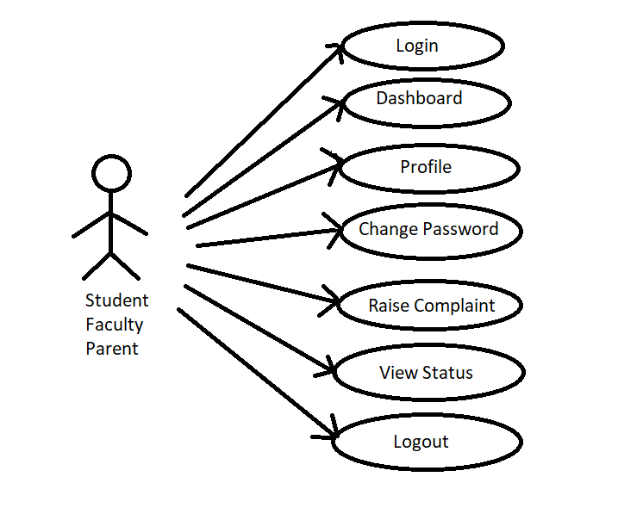
Use case Diagram
Notations
Use cases
Association
Use Case diagram for complaint raiser

Slide 12
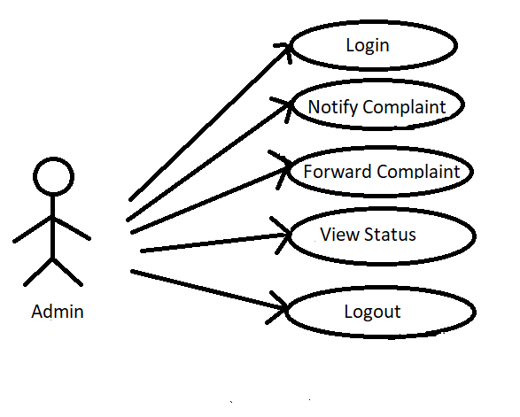
Use case Diagram :
Use case diagram for admin

Slide 13
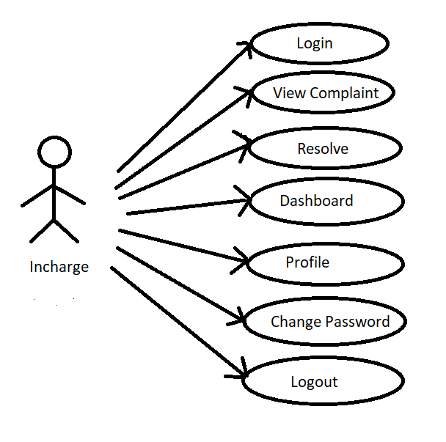
Usecase Diagram
Use Case Diagram for Incharge(complaint resolver)

Slide 14
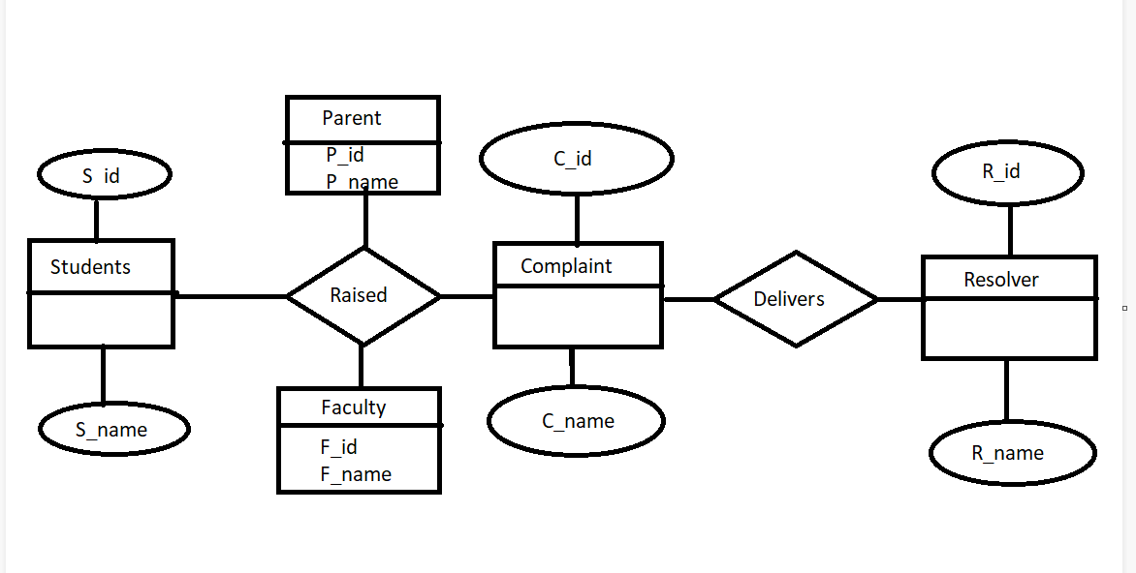
E-R diagram:

Slide 15
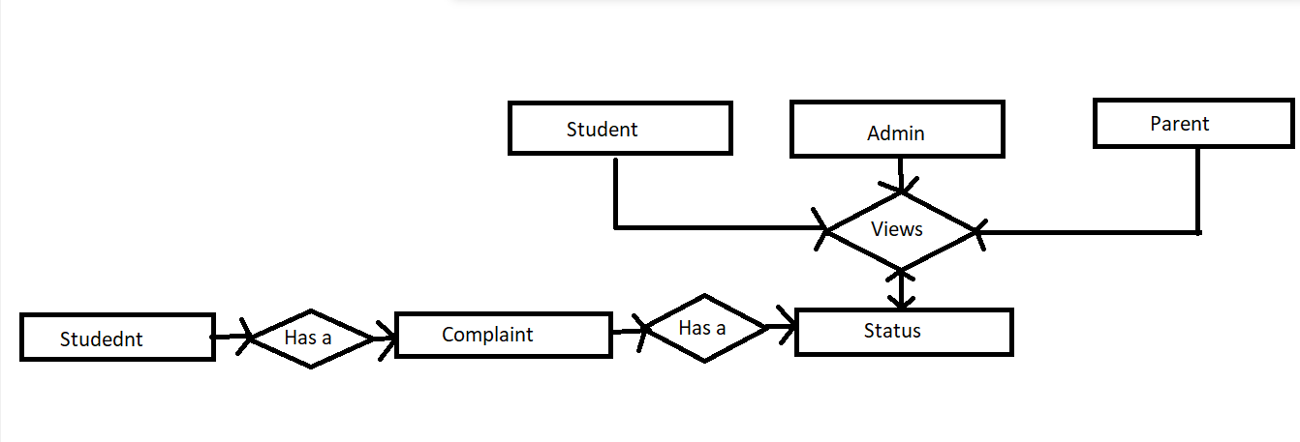
E-R diagram:

Slide 16
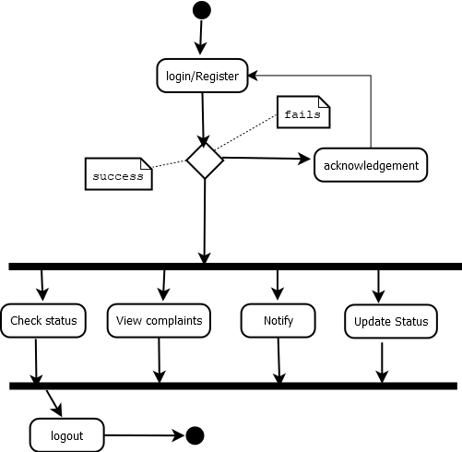
Activity Diagram for Admin:
Notations
activity
Action flow
Decision

Slide 17
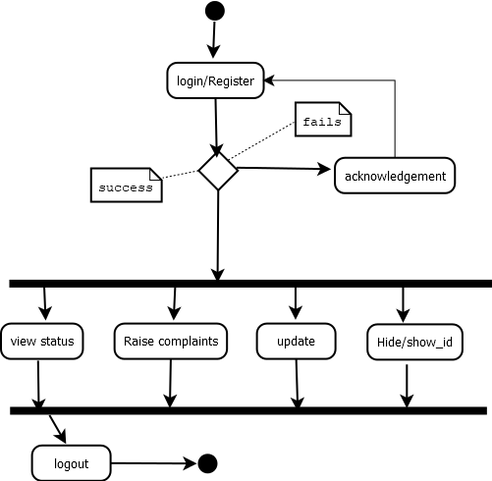
Activity Diagram for Complaint Raiser:

Slide 18
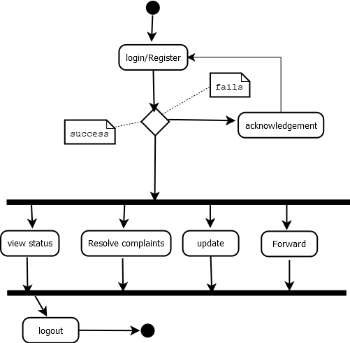
Activity Diagram for Resolver:

Slide 19
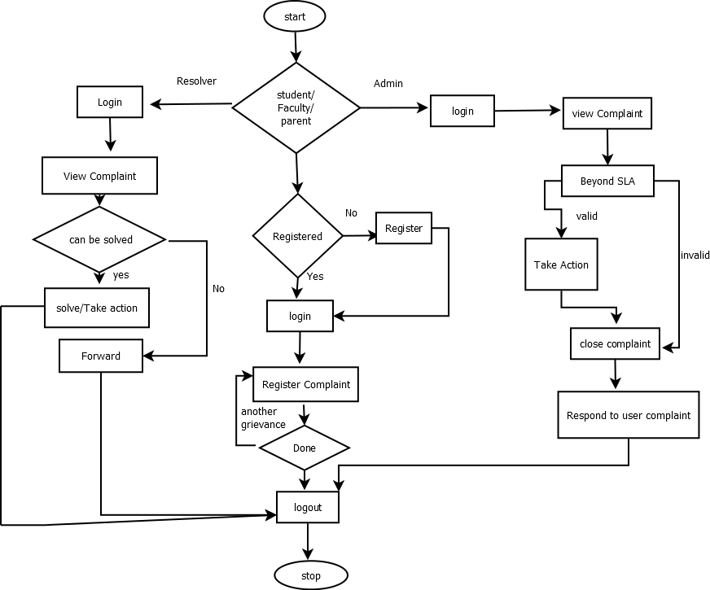
Flowchart:

Slide 20
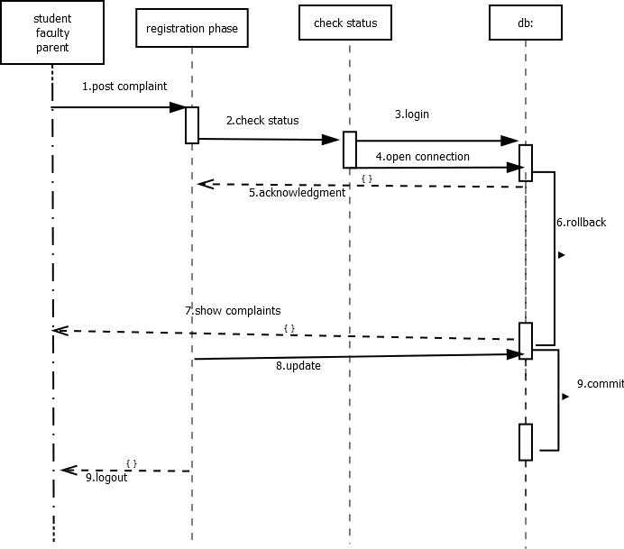
Sequence Diagram:

Slide 21
Implementation
CodeIgnitor
For building dynamic sites with PHP, we are using CodeIgnitor which is an open-source software rapid development web framework. It provides out of the box libraries for connecting to the database and performing various operations.
Features:
Model-View-Controller Based System.
Extremely Light Weight.
Full Featured database classes with support for several platforms.
Query Builder Database Support.
Form and Data Validation.
Security .
Session Management.
Email Sending Class.

Slide 22
Contd…
XAMPP:
Our website requires a server to run. XAMPP is a platform that furnishes a suitable environment to test and verify the working of project based on Apache, Perl, MySQL database, and PHP through the system of the host itself. It's a open source Apache server distribution with MariaDB (formerly MySQL), PHP, and Perl. XAMPP is available for all major operating systems, and is extremely easy to install and use.
XAMPP has the ability to serve web pages on the World Wide Web. A special tool is provided to password-protect the most important parts of the package. XAMPP also provides support for creating and manipulating databases in MariaDB and SQLite among others.

Slide 23
Contd…
phpMyAdmin:
phpMyAdmin is one of the most popular applications for MySQL database management. Through this software, we can create, alter, drop, delete, import and export MySQL database tables.
Features:
Browse databases, tables, view, fields and indexes.
Create/Copy/Drop/Rename databases, tables, view, fields and indexes.
Server maintenance, database/tables configuration proposal.
Execute, Edit and bookmark SQL statements, batch queries.
Manage user accounts and privileges.

Slide 24
Contd…
MySQL:
MySQL is a relational database management system, and ships with no GUI tools to administer MYSQL databases or manage data contained within the databases. Users may use the included command line tools or use MYSQL “front ends”.
Features:
MySQL is released under an open-source license. So you have nothing to pay to use it.
It is a very powerful program in its own right. It handles a large subset of the functionality of the most expensive and powerful database packages.
It uses a standard form of the well-known SQL data language.
It works on many operating systems and with many languages including PHP, PERL, C, C++, JAVA, etc. and works very quickly and works well even with large data sets.
MySQL is very friendly to PHP, the most appreciated language for web development.

Slide 25
Sample code:
CREATE TABLE `user_tl` (
`user_id` int(11) NOT NULL AUTO_INCREMENT,
`username` varchar(50) NOT NULL,
`full_name` varchar(50) NOT NULL,
`password` varchar(256) NOT NULL,
`created_date` datetime NOT NULL,
`user_ref_id` text NOT NULL,
`status` varchar(45) NOT NULL,
`token` text NOT NULL,
`mobile` varchar(45) DEFAULT NULL,
PRIMARY KEY (`user_id`))

Slide 26
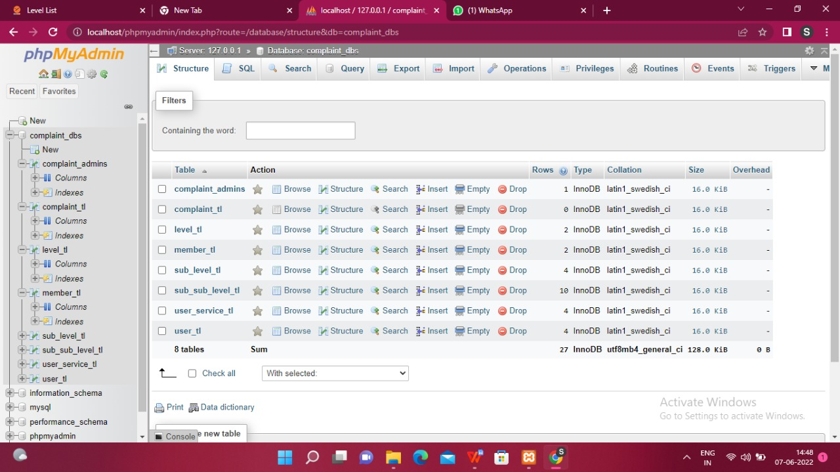
Screenshots (Project Outputs)
Importing database in PHPMyAdmin

Slide 27
Input and Output screen Design
Here we have three login pages:
Admin login
User login
Incharge login

Slide 28
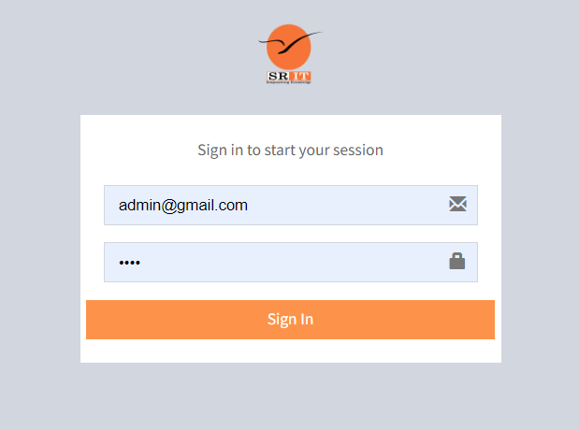
Admin login

Slide 29
Contd…
The elements that are provided in the admin dashboard are
Service Management
Service list
Sub-service list
Sub sub-service list
Officer Management
Officers list
Complaint Management
Pending complaint list
Accepted complaint list
Rejected complaint list
Change password
Sign out.

Slide 30
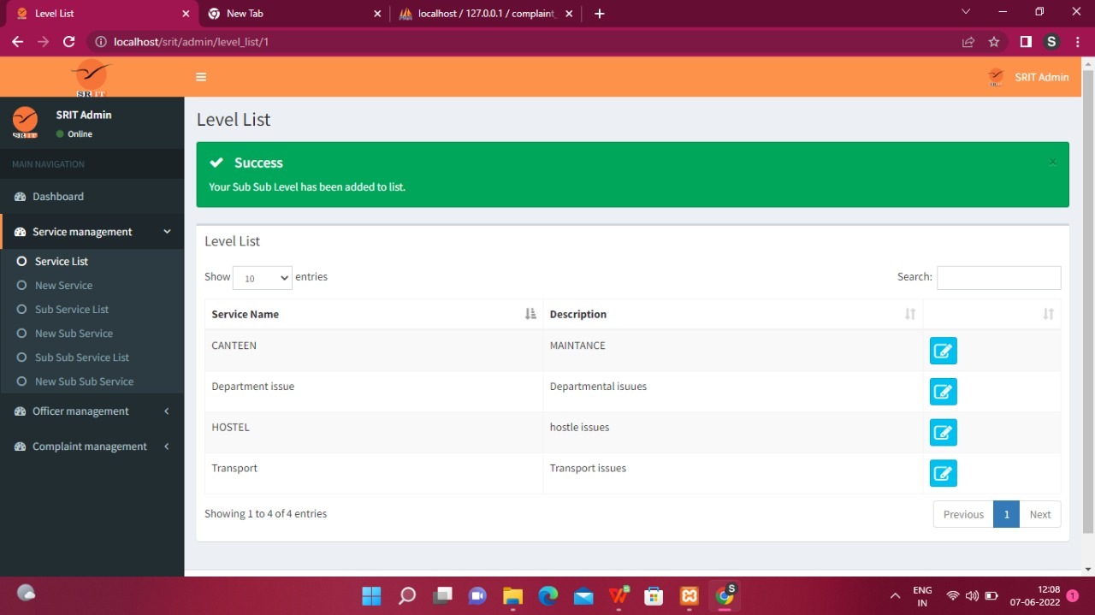
Contd…
The servicer list provides all the grievances list that are submitted by the students/faculty.

Slide 31
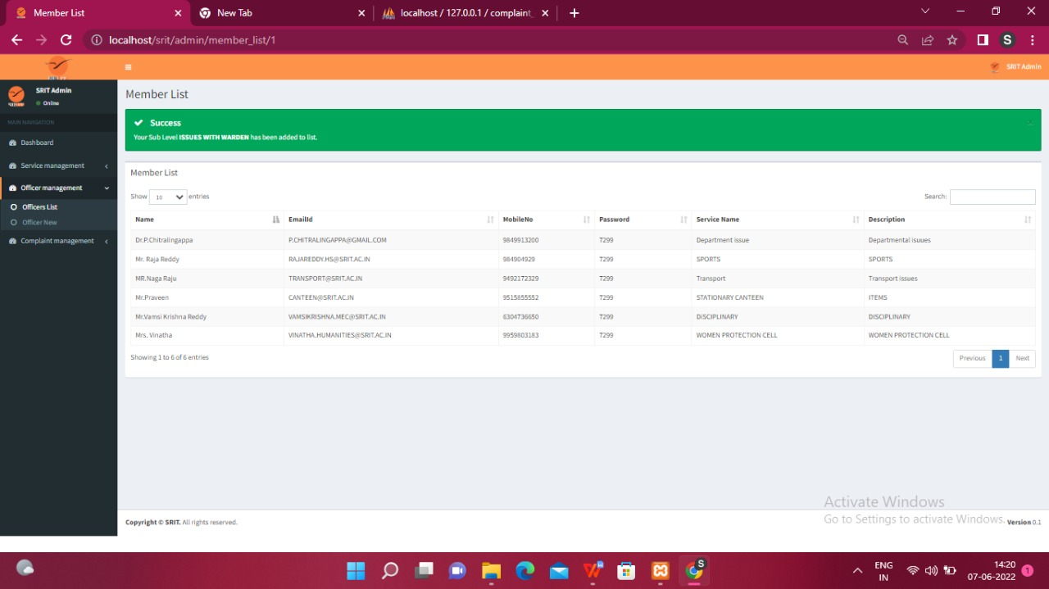
Contd..
The officer management list provides the list of all the in chargers that will solve the respected problems/grievances

Slide 32
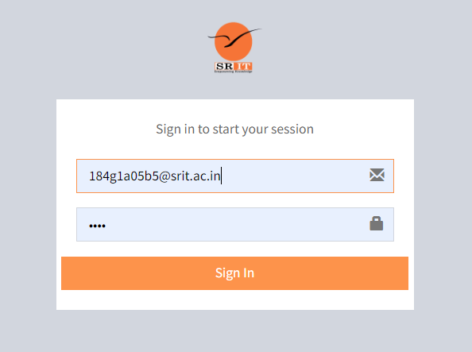
User Login

Slide 33
Contd…
The elements that are provided in the User dashboard are
1. Dashboard
2. Complaint management
My complaint list
Apply new complaint.
3.Change password
4. logout

Slide 34
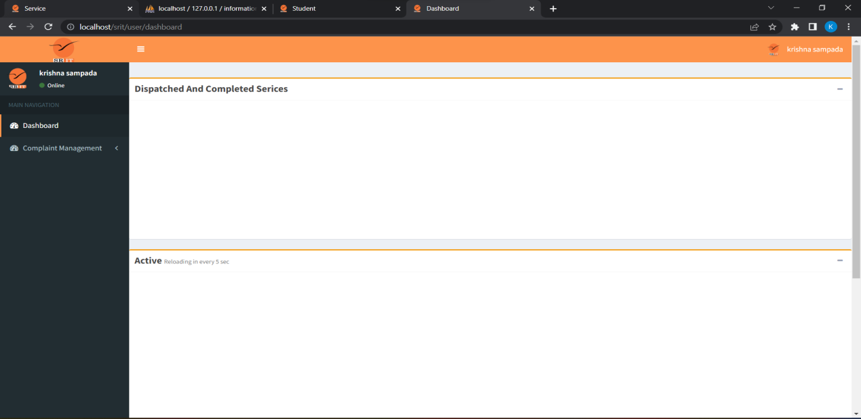
Dashboard of the User looks like

Slide 35
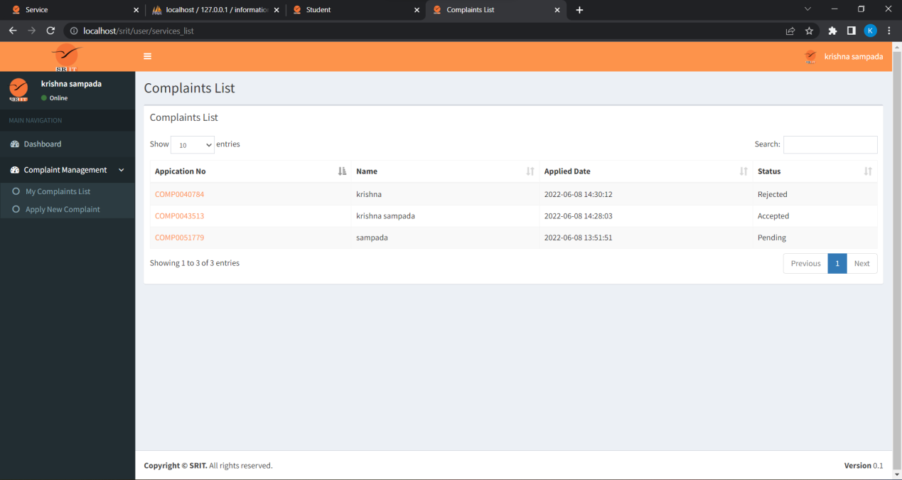
The Complaint management session provides the information about the complaint list that are raised by the user, and also provides to raise a new complaint.
User can able to see his/her complaint history in my complaint list

Slide 36
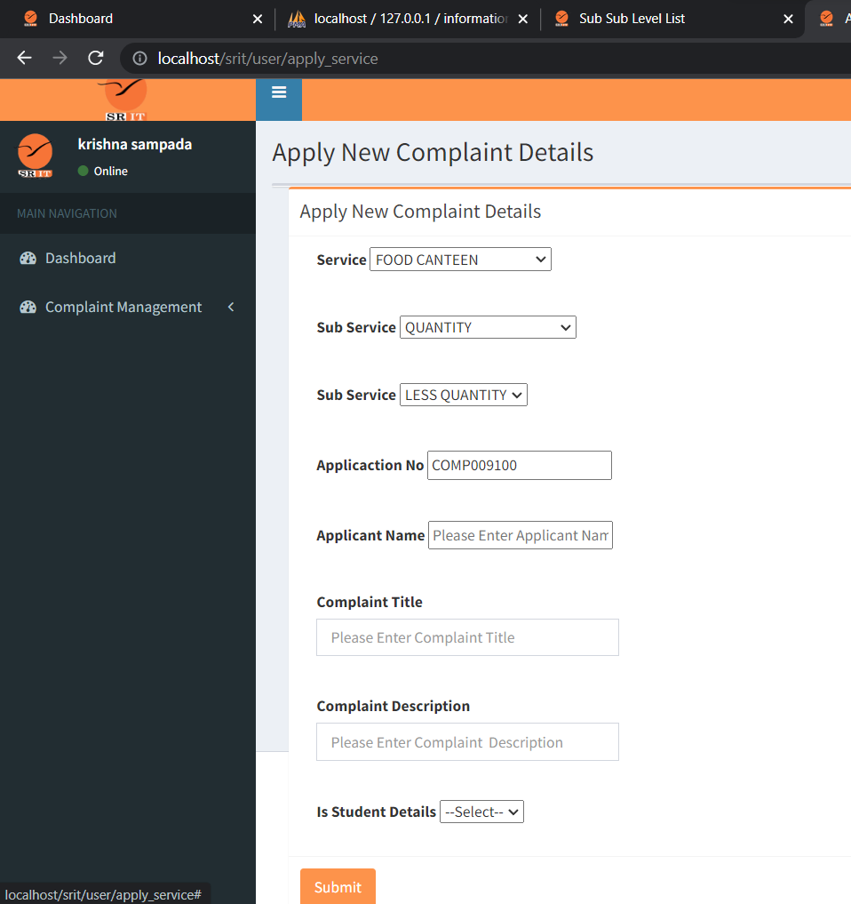
User can apply new complaint

Slide 37
Incharge Login
The elements that are provided in the Member dashboard are
Dashboard
Complaint Management
Pending complaint list
Accepted complaint list
Rejected complaint list
3. Change password
4. Sign out.
Member can login in his login page to view the raised complaints

Slide 38
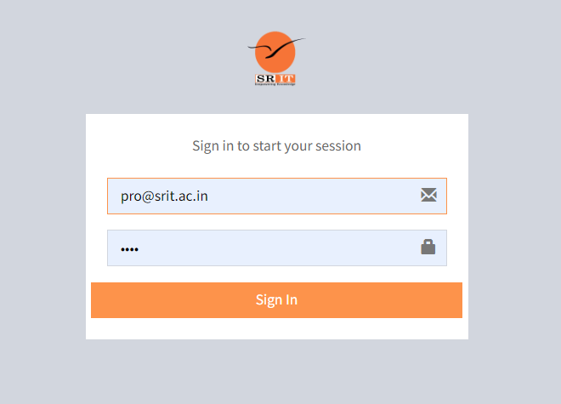
Member login

Slide 39
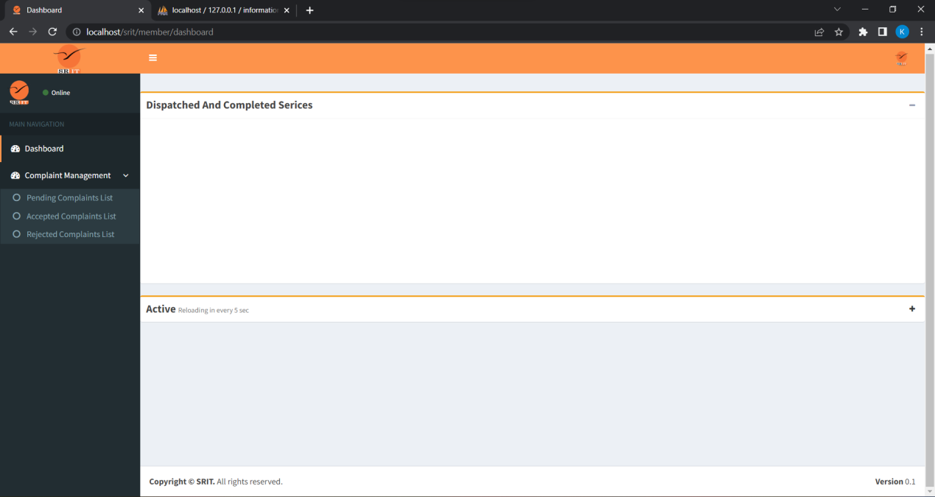
Contd…
The dashboard of the member/incharge

Slide 40
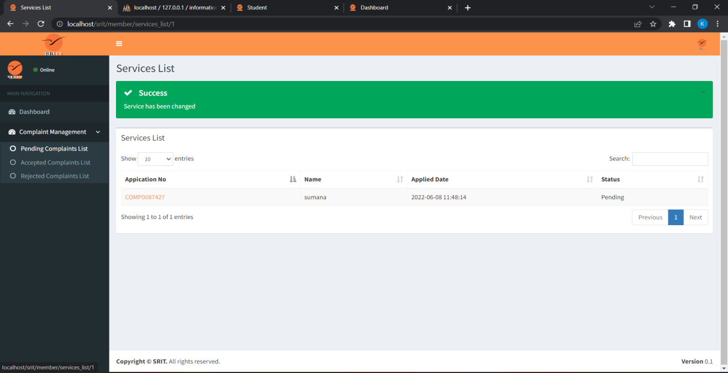
Contd…
The Complaint management session provides the information about pending, accepted and rejected complaint list.
The complaints that are yet to solve are viewed in pending complaints

Slide 41
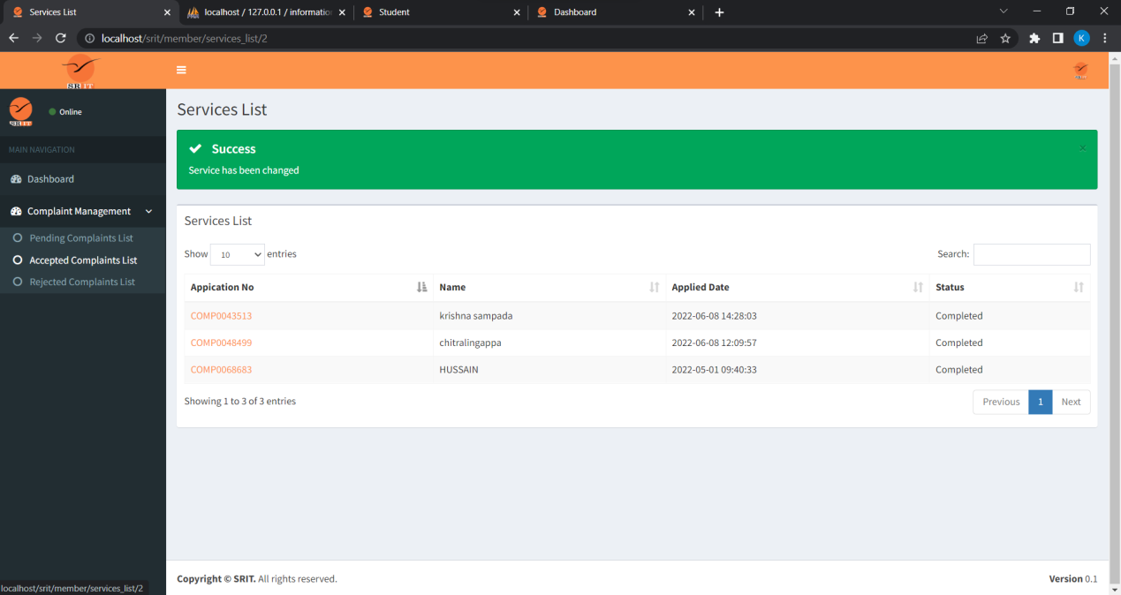
Contd…
The complaints that are accepted and solved are listed in Accepted Complaint List

Slide 42
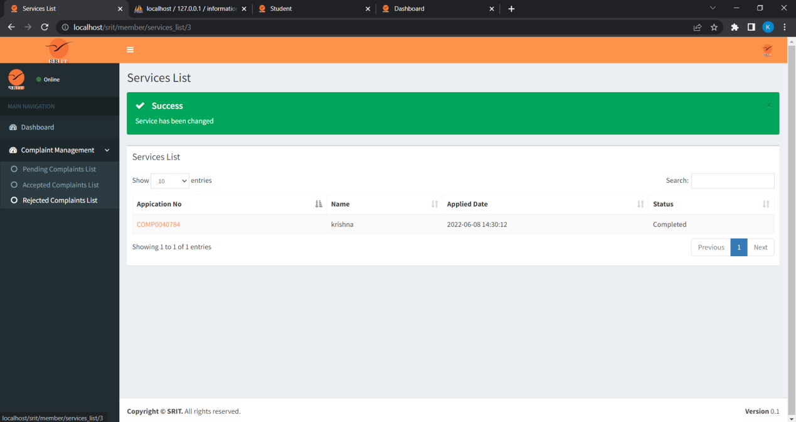
Contd…
The complaints rejected are viewed in Rejected complaint list

Slide 43
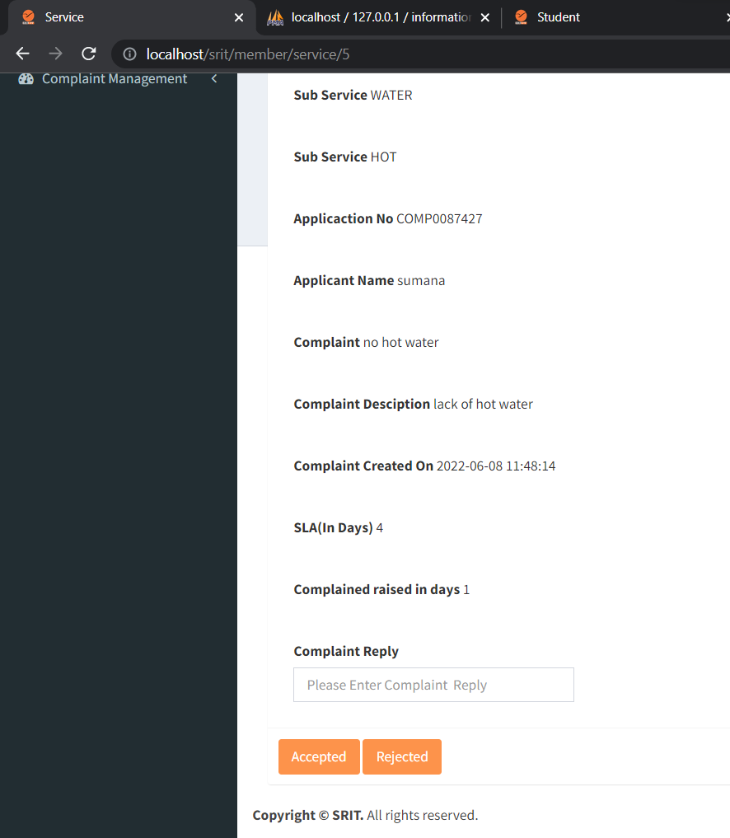
Contd…
He can accept or reject the complaint by clicking accepted and rejected by giving reason by replying the complaint.

Slide 44
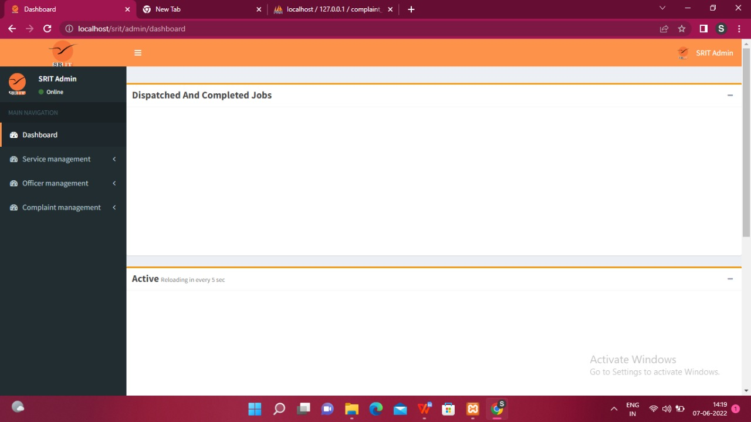
Contd…
Admin Dashboard

Slide 45
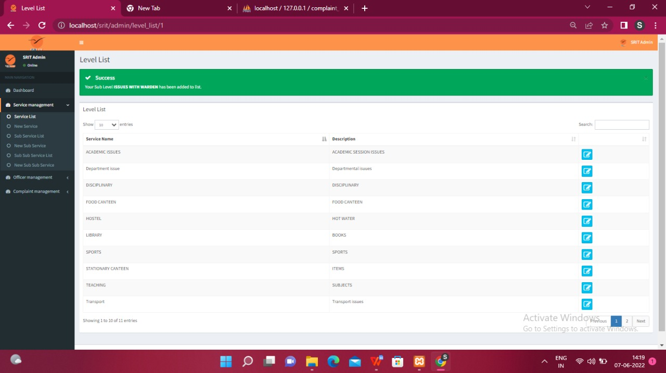
Contd…
List of Issues

Slide 46
Contd…
Incharges of respected issues

Slide 47
Contd…
Service Name and Description

Slide 48
Conclusion
With the development of a Grievance Redressal System, student and other grievances will be immediately addressed, and aggrieved students, teachers, and parents in higher educational institutions will receive timely assistance.
There are primarily two interfaces in the College Grievance Management System.
A user interface for students and an admin/grievance cell member's interface for controlling the entire system are included in the completely automated system.

Slide 49
Contd…
The Smart Complaint Management System displays the current status of the complaint, indicating whether it is in the process of being resolved or has been resolved.
Only the administrator can check or resolve the complaint because it is based on centralised administration.
The ability for an Admin to delete a User. Checking the current status of complaints and amending the status of complaints is centralised management.
The system's administrator can generate a report for whatever date range he chooses.

Slide 50
References
[1]Shaligram Prajapat, “A Prototype for Grievance Redressal System”, DOI:10.1007/978-981-10-8198-9_5, Shaligram Prajapat, Jan.2018.
[2] 1Devika Radhakrishnan, “Smart complaint management system”. IJTRD | Nov-Dec 2016.
[3] Mukesh Buldak1, “An online Grievance Redressal System”, vol. 11, pp. 11-15, Shrikant Pandhekar, Mar. 2019

Slide 51
Thank You!!!

